Slide 1
Cloud Administration and Security
Tarun Vats

Slide 2
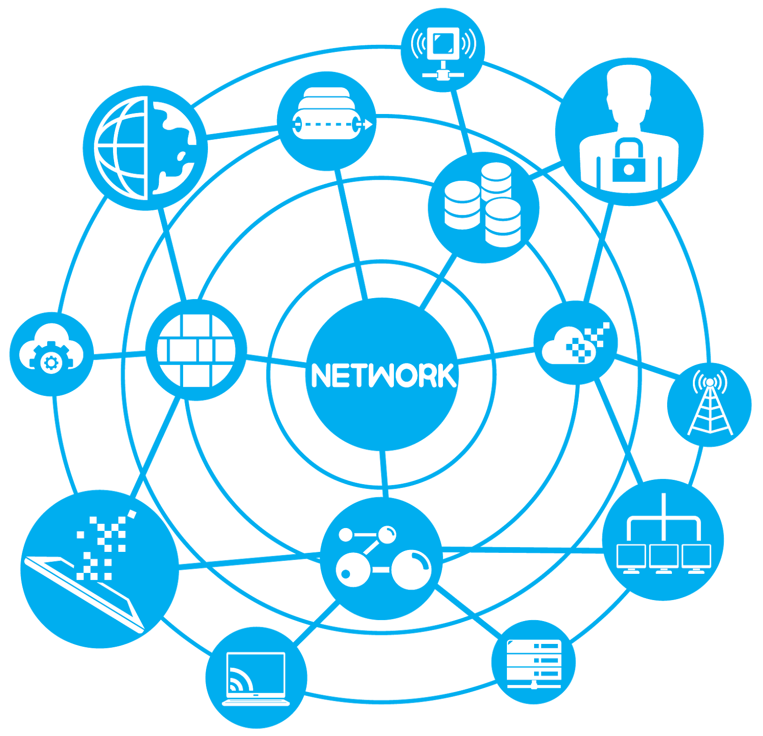
Course Curriculum In A Nutshell
Day 1
Day 2
What is a web application and its components.
How web applications and its components look in the Cloud ecosystem.
Day 3
Day 4
Day 5
How web applications are connecting and communicating in the Cloud ecosystem.
How to secure this Cloud ecosystem.
How automation(scripts) helps to manage all above 4.

Slide 3
Any Question

Slide 4
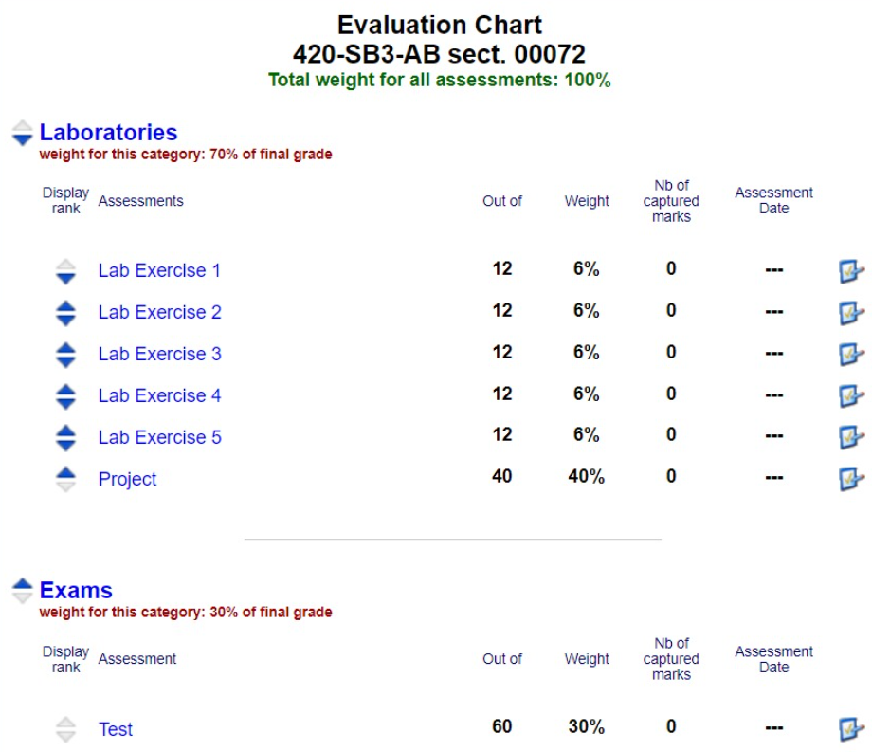
Evaluation Plan

Slide 5
Introduction to Web application , Components and web application architecture
Tarun Vats

Slide 6
Agenda
1. Web Application
2. Its Components
Introduction
What happens when you go www.google.com
Browser/ Client
Server / Web Server
Database
3. Traditional and Modern Architectures
4. OS and Scripting Language
Monolithic Architecture
Microservice Architecture
Use cases
Advantages and Disadvantages
- Operating System
- Important OS commands and scripts

Slide 7
1. Web Application
What is it ?
Web application is computer program that performs tasks over the internet using web technologies.
Or
A web application is a computer program that uses a web browser to perform a particular function.
Technologies involved
Web Browser
Web Server
Example
Any website you run on a browser .
www.google.com phone, laptop, desktop, tablets, etc. it is still a web application

Slide 8
Web Application
Client Server Architecture
Web Client (Browser)
Web Server

Slide 9
Web Application
Benefits
It does not dependent on Operating system, Device , and browser as long as developed and tested for specific browser.
All users access the same version .
No installation and download overhead at users side.
Reduce users side resource consumption .
No scope of piracy.
They reduce costs for both the business and end user as there is less support and maintenance required by the business and lower requirements for the end user’s computer .
And many more….

Slide 10
Any Question

Slide 11
Development - Technologies involved
HTLM/HTLM5
JavaScript and JavaScript based frameworks : Angular.js, React .js, Node.jsetc
Java and java based fireworks : Spring boot
Python and Python based framework : Django
Ruby and Ruby based frameworks : Ruby on rails

Slide 12
Development - Technologies involved
Technologies
Frontend
Backend
Front end developers
Backend developers
Full stack developer

Slide 13
Deep Dive – How does it work
What happens when you go www.google.com
Stage 1. Client
System does not about what is google.com. It understand IP addresses.
Browser cache -> OS cache ->Router cache -> ISP cache
The Browser sends an HTTP request to the Webserver

Slide 14
Deep Dive – How does it work
What happens when you go www.google.com
Stage 2. Server
Server
HTTP Request
Web Server
HTTP Response
Request Handler

Slide 15
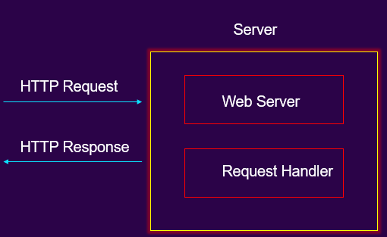
Deep Dive – How does it work
Stage 2. Server – Types of Web Servers
1. Static Web Server : Sever will send hosted files as is to a browser.
2. Dynamic Web Server: Server can be used to update any hosted files before they are sent to a browser. Utilizes application server and DB features to update the content.

Slide 16
What happens when you go www.google.com
Stage 3. Browser Rendering
Get layout.css Get image.png
Get page.html
Get video.mp4
Get ads.jpg
Web Server
image
Video
Ads
Video Server
Web Document
Ads Server

Slide 17
Any Question

Slide 18
2. Web Application : Components
All web-based database applications have three primary components: A web browser (or client), a web application server, and a database server.
1: Client
2: Server: Web Server
3: Database server

Slide 19
Database Server
Web-based database applications rely on a database server. It provides the data for the application.
Examples

Slide 20
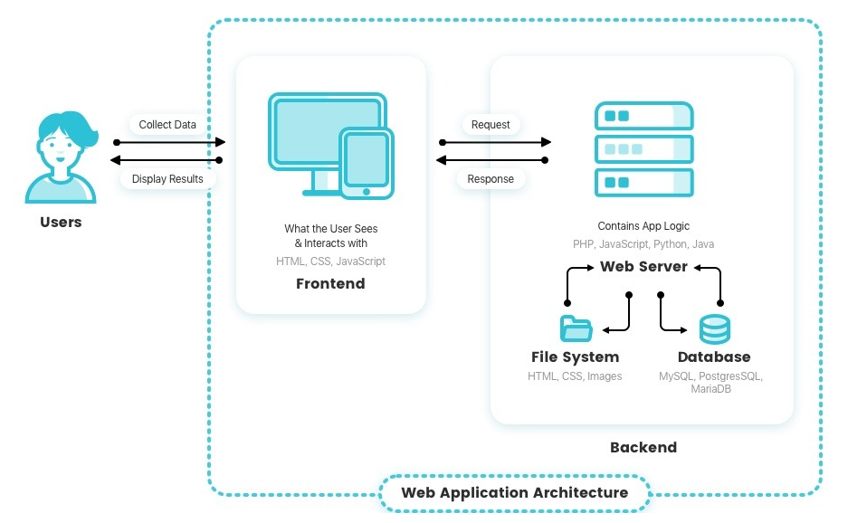
Database Server
Web-based database applications rely on a database server. It provides the data for the application.
Placement of DB Server in Web application architecture

Slide 21
Any Question

Slide 22
3. Web Application : Traditional and Modern Architectures
Web Application Architecture
It describes the structure and communication of the components involved in a website.
Components like : Frontend , business logic/middle ware , databases
Monolithic web applications
Style 1 :
Microservice web applications
Style 2 :

Slide 23
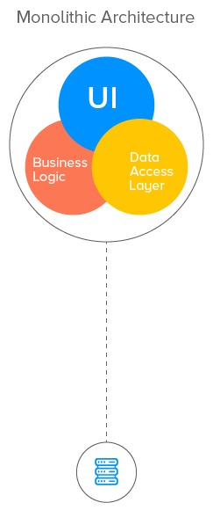
Web Application : Traditional and Modern Architectures
Monolithic web applications
An application which has single code base.
Every thing business logic, UI , Data Access layer all bundled and deployed to server as single unit.
EStore UI
Catalog
Service
Order
Service
Payment
service
Product
Order
Payment
DB
E Commerce application

Slide 24
Web Application : Traditional and Modern Architectures
Monolithic web applications
An application which has single code base.
Every thing business logic, UI , Data Access layer all bundled and deployed to server as single unit.
EStore UI
Catalog
Service
Order
Service
Payment
service
Product
Order
Payment
DB
E Commerce application

Slide 25
Breakout Room Time
Lets Build Instagram web application as monolithic web application

Slide 26
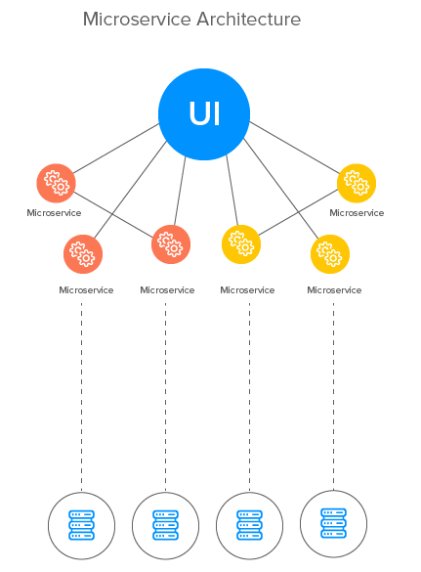
Web Application : Traditional and Modern Architectures
Microservice web applications
In Microservice architecture , contains a mix of small and autonomous services where every service is implemented as a single business ability.
Important: Instead of sharing a single database as in a Monolithic application, each microservice has its own database

Slide 27
Web Application : Traditional and Modern Architectures
Microservice web applications
Catalog
Service
DB
Cart
Service
DB
EStore UI
Order
Service
DB
Payment
service
DB
E Commerce application

Slide 28
Example : WWW.Amazon.ca

Slide 29
Breakout Room Time
Lets Build Instagram web application as Microservice web application

Slide 30
Monolithic vs Microservice
Monolithic : Advantages
Monolithic : Dis-Advantages
Zero Deployment dependencies
Error Tracing
Scalability is Limited
Lack of flexibility
Deployment process
Development dependencies
Single point of failure
Microservice: Advantages
Microservice: Disadvantages
Independent Development
Independent deployment
Mixed Technology and Effective updating
Granular Scaling
Performance
Complexity: too many versions
More Complicated Testing
Security
Performance
Some additional overhead

Slide 31
Monolithic vs Microservice
Conclusion
Well, both approaches have their pros and cons,
but it depends on each scenario or product/project requirements and which tradeoff you choose.
As the monolithic approach best suits lightweight applications.
It is recommended to adopt the Monolithic approach first and depending on the needs/requirement gradually shift towards the Microservices approach.

Slide 32
Discussion / Q&A Break

Slide 33
Operating System
- What is an Operating System
- Operating System roles
- Linux File System
- Important command
- Shell Scripting

Slide 34
Operating System
- What is an Operating System
An Operating System is a program/interface that runs between a computer user and computer hardware.
Other User programs utilize OS core programs to perform tasks.
User1
User2
User N
Software
System Software
Application Software
Operating System
Hardware
CPU
RAM
I/O

Slide 35
Operating System
- Some Popular Operating Systems
https://upload.wikimedia.org/wikipedia/commons/b/b5/Linux_Distribution_Timeline_21_10_2021.svg

Slide 36
Operating System
- Operating System is Everywhere
PC
Laptop
Mobile (windows, Android(Linux), apple)
Watches (Fitbit)
ATMs
Any Kiosk (self-checkout Machine)

Slide 37
Operating System
- Operating System Functions
Processor/Process Management
Memory management
File & Storage Management
Device Management

Slide 38
Operating System
- Operating System Functions
Processor/Process Management
Process Scheduling: OS decides which process gets the processor
OS Does:
Keeps track of processor and status of the process.
Allocates the processor (CPU) to a process.
De-allocates processor when a process is no longer required.

Slide 39
Operating System
- Operating System Functions
Memory management
Main memory is a large array of words or bytes where each word or byte has its own address.
Main memory provides fast storage that can be accessed directly by the CPU
OS Does :
Keeps the track of used, unused, and Used by whom part of memory.
OS decides which process will get memory when and how much.
Allocates the memory when a process requests it to do so.
De-allocates the memory when a process no longer needs it or has been terminated
Addresses
Main Memory

Slide 40
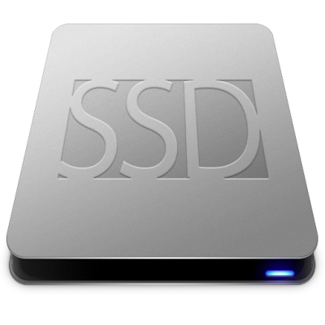
Operating System
Main Memory
- Operating System Functions
File Management
A file system is normally organized into directories.
These directories may contain files and other directions.
OS Does :
It regulates which process gets the file and for what duration.
it keeps track of information, location, uses, status, etc.
how to store data or files into the computers and how users will access the files.
Inodes and File structure. (NTFS, FAT, FAT32, EXt3, Ext4, Etc)
Addresses

Slide 41
Operating System
Main Memory
- Operating System Functions
Device Management
Operating System manages device communication via their respective drivers.
Devices like Sound interface card for sound input output
Network interface card for Wi-Fi, Ethernet, Bluetooth, etc.
VGA interface card for High-resolution Output
USB for Mouse, Keyboard another type of devices.
OS Does :
Keeps track of all devices. I/O controller is responsible for this task
Decides which process gets the device when and for how much time.
Allocates the device in an efficient way.
De-allocates devices.
Addresses

Slide 42
Operating System
Main Memory
- Why we are learning it?
Addresses

Slide 43
Operating System
- Some Important commands
Top : track of running process
Ps: process status
Kill (kill a process)
Nice [value -20 to 19] process name
FG . BG , &
/proc
free or /cat /proc/meminfo: Status of main memory usage
htop: will tell you memory load of each process
Ipconfig, Nslookup, Ping, Lsof Netstat –antu : Neworking utilities
Lsmod: list of connected devices
Lsusb, Lscpu ,Lshw,ls pcihwinfo,lsblk : Other hardware devices info
Touch/mkdir/rmdir/rm/mv/rename: create delete files and folders
Df / df -h: disk free space
du: estimate file disk usage in a directory
Fdisk: format a disk

Slide 44
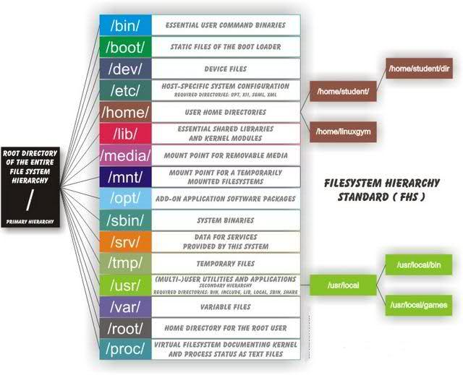
Operating System
Linux Directory Structure

Slide 45
Shell and Shell Scripting
Shell
The shell is the Linux command line interpreter.
It provides an interface between the user and the kernel and executes programs called commands.
For example, if a user enters ls then the shell executes the ls command.
Shell Script
A shell script is a text file that contains a sequence of commands for a UNIX-based operating system.

Slide 46
Lets Setup AWS account

Slide 47
Assignment 1 Discussion

Slide 48
Project Discussion

Slide 49
Some Imp. Topics
https://12factor.net/ - The Twelve Factor APP
Multi tenant vs single tenant Architecture

Slide 50
Thank you
Tarun Vats​​
​Tarun.vats@johnabbott.qc.ca​
​

