Slide 1
Spring Boot web application group project: Boobady Shopping Cart
(420-JD5-AB) Programming III Summer 2022

Slide 2
The Basics
The scope of the project — and the research it required — made it impossible to divide into individual “contributions.”
We named our team FSD-404 (Error 404, get it? 😏)
Instead, we designed, researched, and ultimately built our project together on TEAMS as Hossein and Amir took turns sharing their screens. Although working together step-by-step slowed our progress, it was an exercise in working as a team and accomplishing a common goal.
Our team members are Ilnaz Alizadeh Ghannad, Kristy Hoffman, Hossein Parsa, and Amir Sharifi.

Slide 3
Description
In short, our project is a web application that facilitates online shopping. It includes categories of products (there is no limit to the number of either) as well as pages and a checkout process.
We used Bootstrap for our front-end framework and a combination of Java, Spring Boot, and our IDE to build the rest of the project.
There are two "perspectives" through which someone can access it: user and admin. Both require login credentials.

Slide 4
Functionalities
An overview of the functionalities of our web application, Boobady Shopping Cart, can be divided according to the two “perspectives” mentioned in the previous slide.
Admin functionalities include creating and adding pages, categories, and products.
User functionalities include selecting products to add to a shopping cart and paying for the products via a checkout process.

Slide 5
Problems, challenges, and solutions
As a team, we encountered challenges while building our web application.
Overall, our greatest challenge was determining how we could best layer the data; that is, how we could define our entities and connect them to create an organized, logical, and comprehensive infrastructure.
While Spring Boot has many (super dope) tools, we were not sure which ones were best suited for the tasks we had before us.
We found the solutions to our problems within a combination of research, collaboration, patience, perseverance and perhaps most importantly, experimentation.

Slide 6
Problems, challenges, and solutions example
One of the specific challenges we faced while working on our web application relates to Thymeleaf.
At first, we did not understand why Thymeleaf — a server-side Java template engine — provided the option to divide all pages into fragments. For example, we could choose to divide an HTML page into a header, body, footer, etc.
Through trial and error, we discovered that the purpose of that functionality is to prevent us from having to recreate the same components on every page. Instead, we could implement those components or “fragments” through links. Therefore, it helped us become efficient and progress quickly.

Slide 7
Problems, challenges, and solutions
Here is a partial list of our project’s dependencies, all of which we selected based on our research.

Slide 8
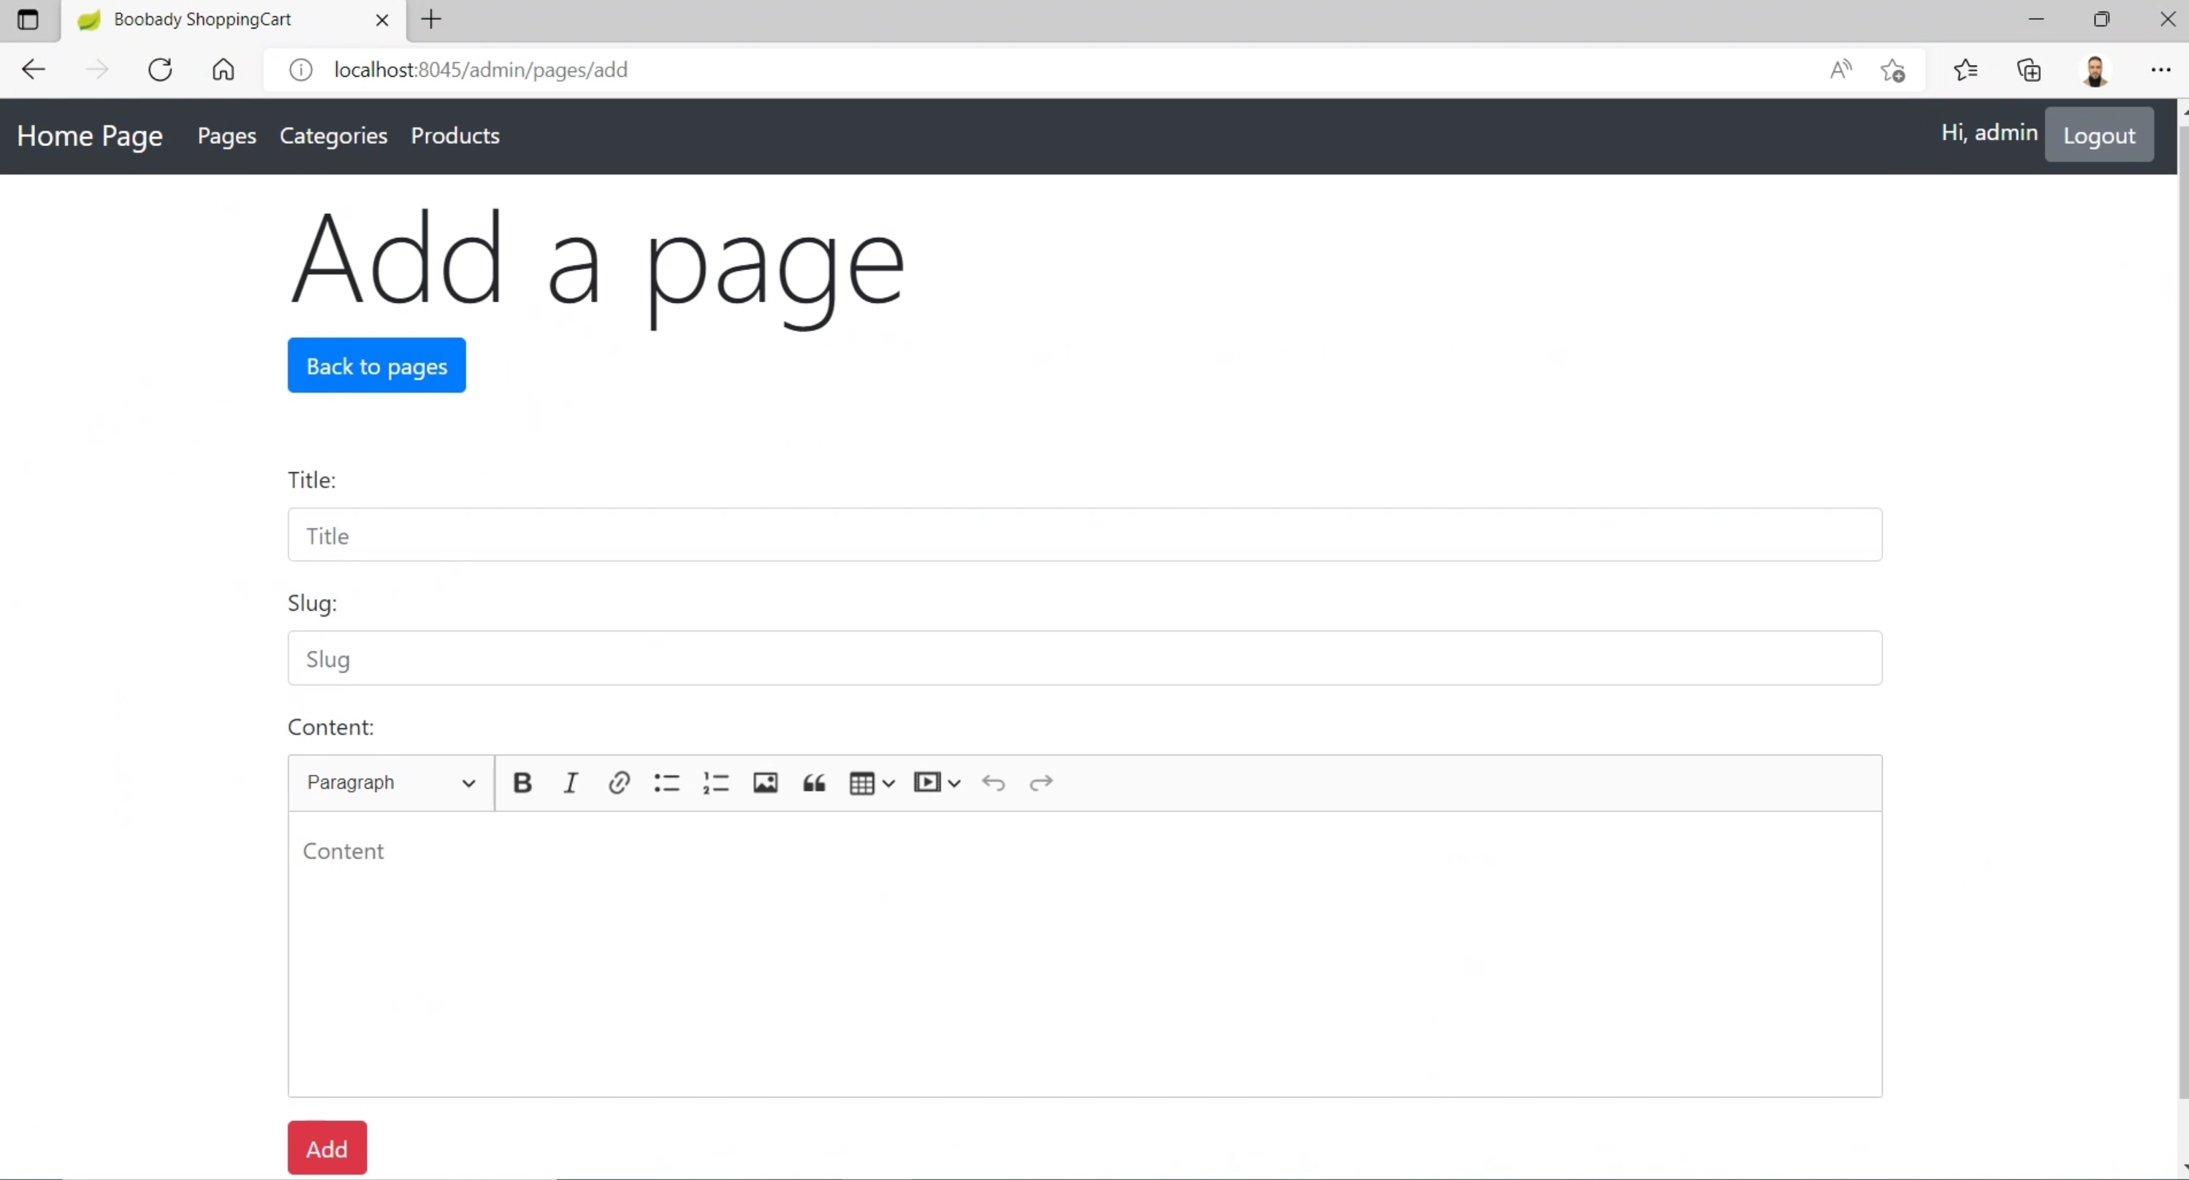
Requirements and functions
In the context of CRUD, “create” relates to an admin’s ability to create pages, categories, and products.

Slide 9
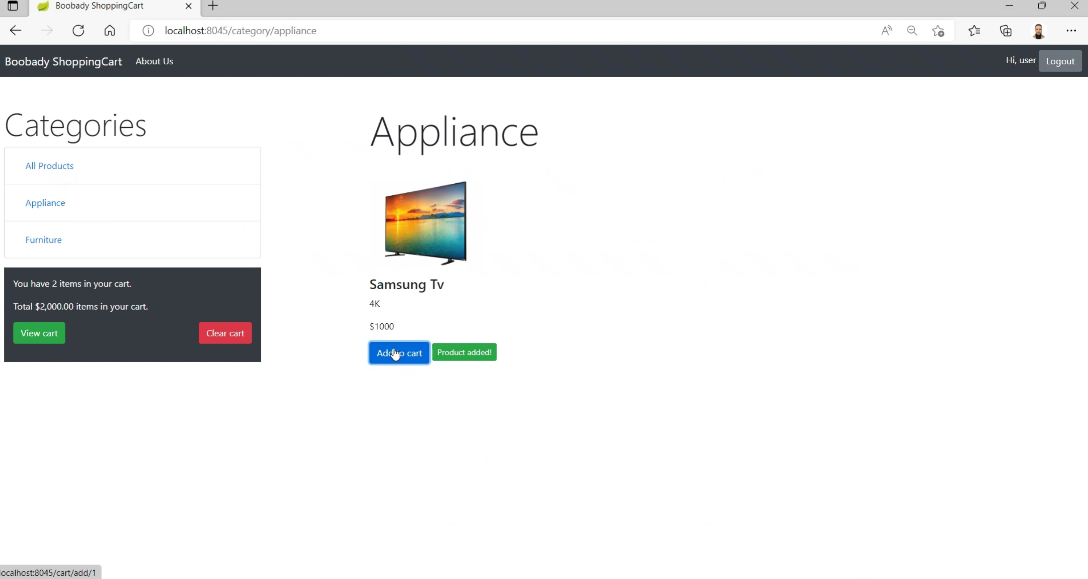
Requirements and functions
Our web application’s ability to read from a database fulfills CRUD’s “read” aspect. Users update their carts (that is, add or remove items), and admins update pages, categories and products with general and inventory-related information. Admins may delete pages, categories and products, too.

Slide 10
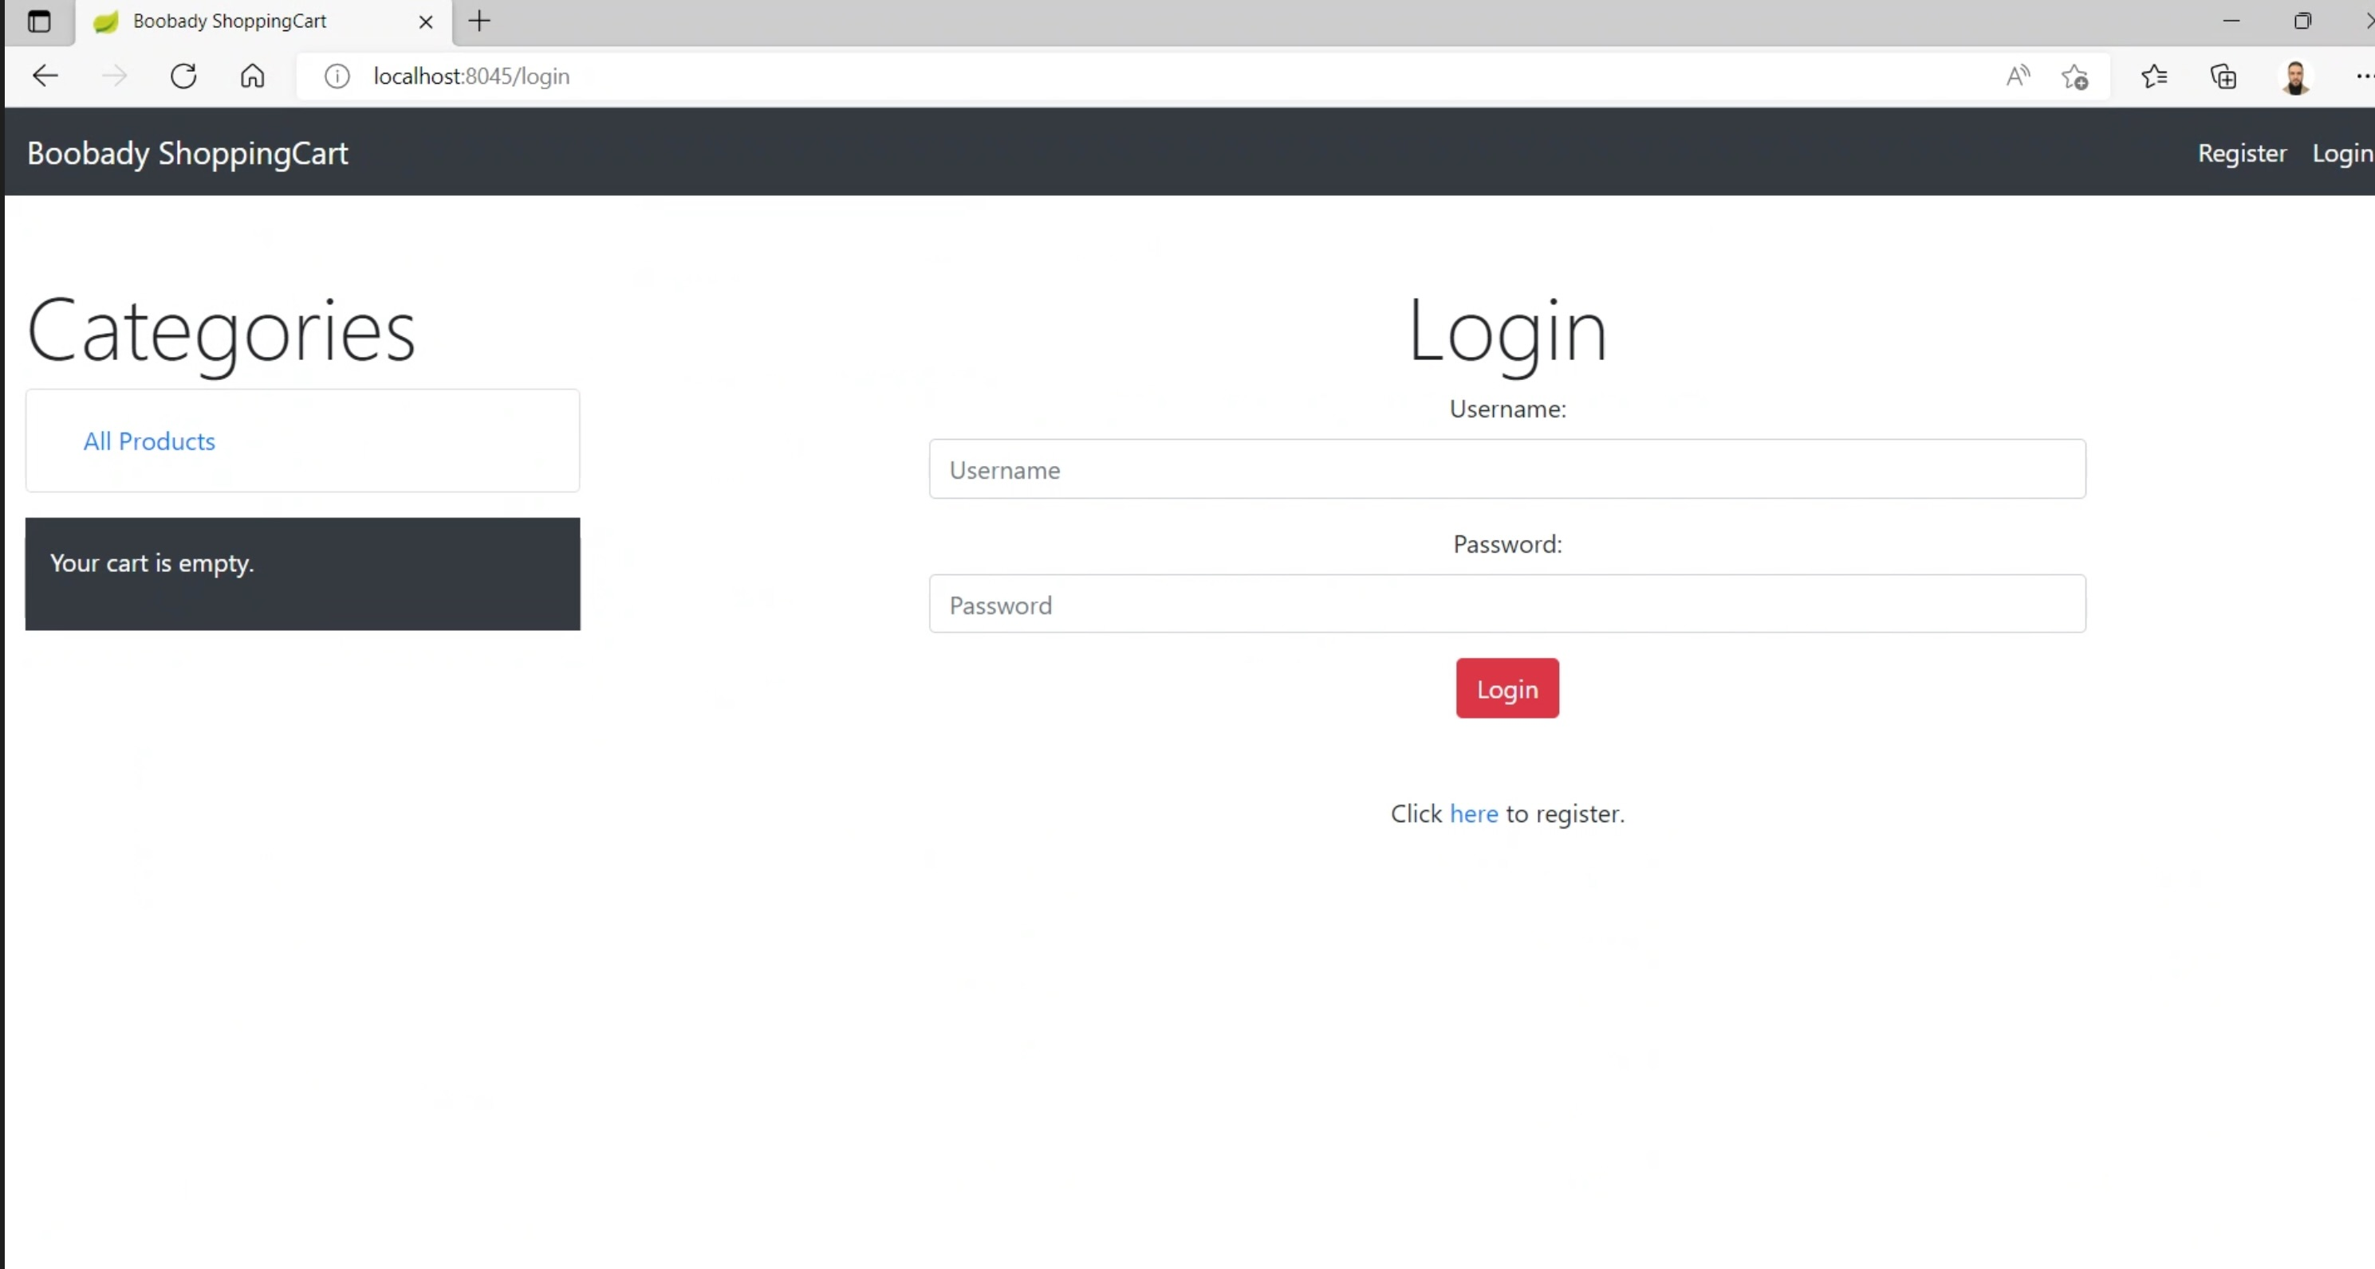
Requirements and functions
Both users and admins are required to register and login, and authentication takes place after that.

Slide 11
Tables and their relations
Our database includes five tables: categories, users, pages, products, and admin.
As demonstrated in the graphic, a one-to-many relationship exists between categories and products.

Slide 12
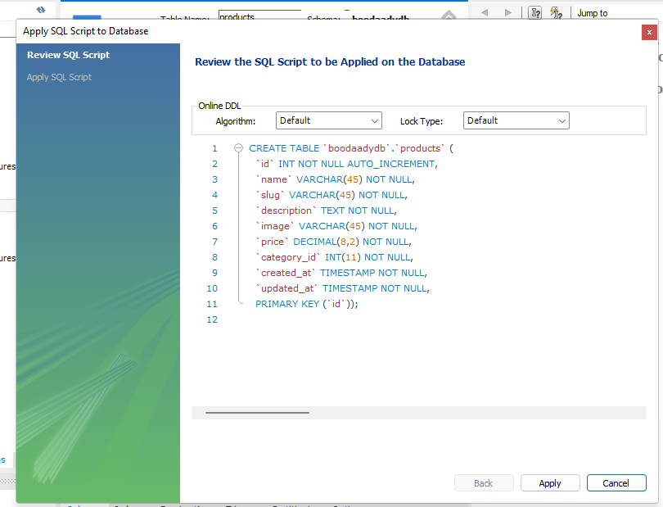
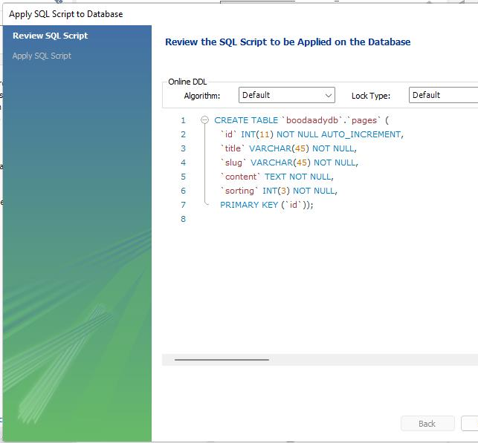
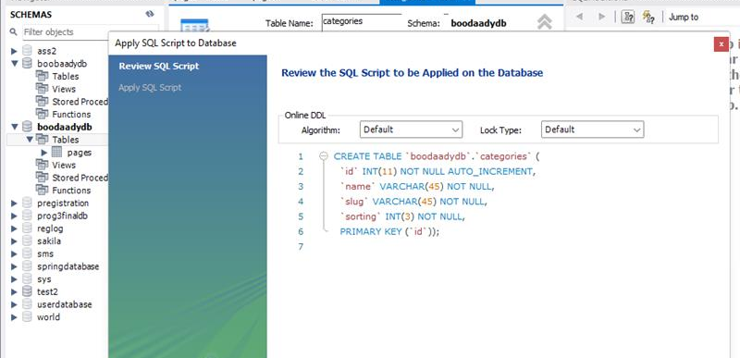
Tables and relations
These are examples of our database code for our pages, categories, and products entities.

Slide 13
Live Demo
I will now pass the presentation to Hossein, who will lead a demonstration of Boobady Shopping Cart. Thank you for listening ☺

